Slide 1
BABEŞ-BOLYAI UNIVERSITY, CLUJ-NAPOCA
FACULTY OF MATHEMATICS AND COMPUTER SCIENCE
SPECIALIZATION SOFTWARE ENGINEERING
DISSERTATION THESIS
Developing an improved algorithm for detection and attenuation of sound distortion in vinyl recordings
✽
Supervisor
Lect. Univ. Dr. STERCA ADRIAN
Author
DRIMBA ALEXANDRU

Slide 2
Content
Introduction and problem description
Previous work
Overlap-Add Short-Time Fourier Transform
A message-passing Java-Python IPC protocol
Performance and accuracy results
Conclusions and personal contributions

Slide 3
Introduction and problem description
In mechanical analog formats, sound is stored as a modulated groove, which is later picked up and converted to either sound or electrical signals by a stylus
Examples of such formats:
Wax cylinders
Shellac records
Tefifon
Vinyl records

Slide 4
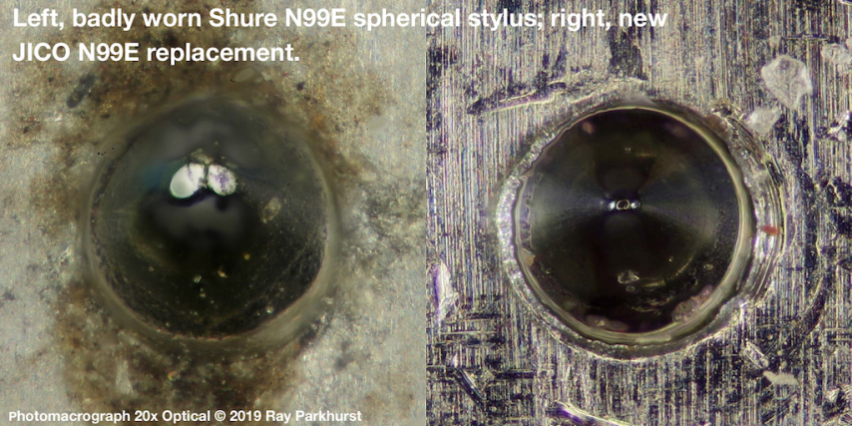
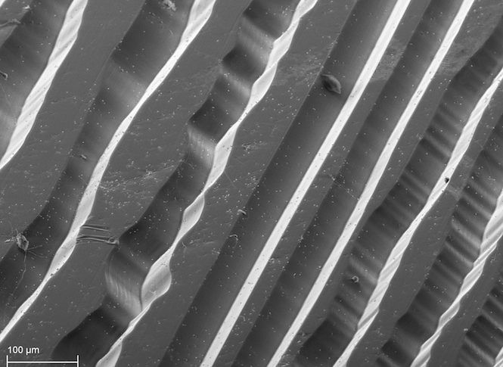
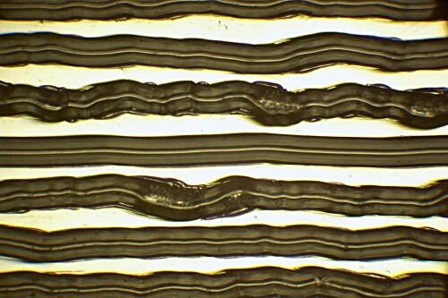
Introduction and problem description
The grooves are prone to accumulation of dust and debris, and to mechanical damage such as scratches and groove wear; these have a negative impact on the sound quality and clarity.
Scratches are generally caused by mishandling, while groove wear is caused by improper playback equipment.

Slide 5
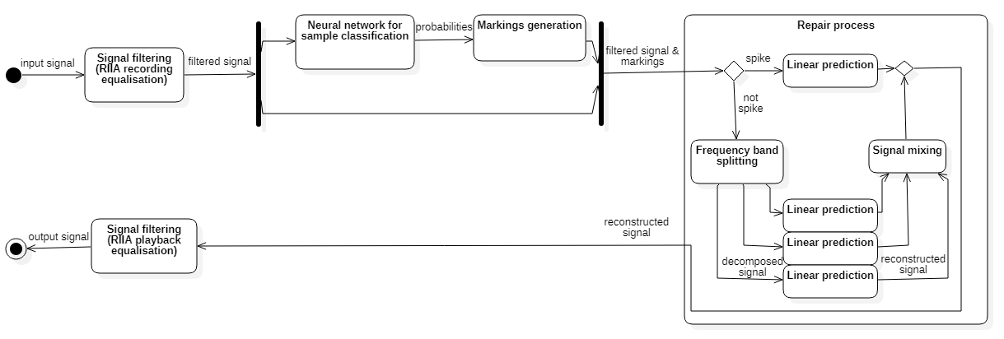
Previous work
One of our previous works already tackled this subject. In it, we have developed an algorithm and application that detects and repairs damage in such recordings.
The processing steps are:

Slide 6
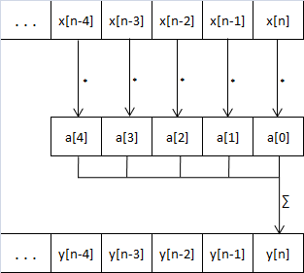
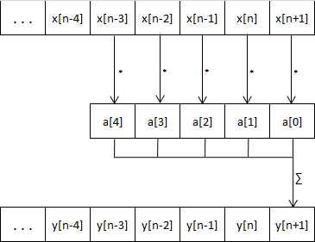
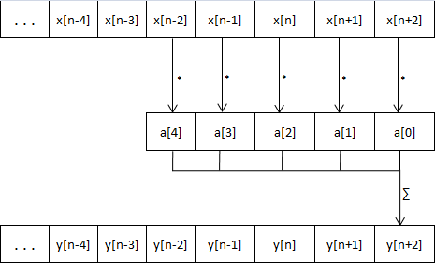
Previous work
Signal filtering:
in our work, filters are used to alter the signal’s frequency response;
implemented using Finite Impulse Response (FIR) filters. A FIR is a time-domain convolution with fixed coefficients;
has a complexity of θ(N*M), where N is the signal length, and M is the number of coefficients.

Slide 7
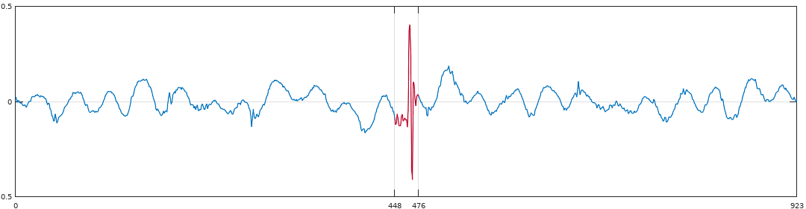
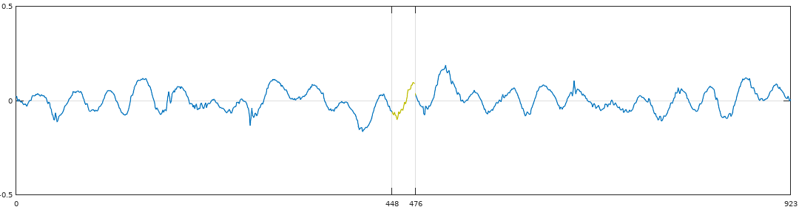
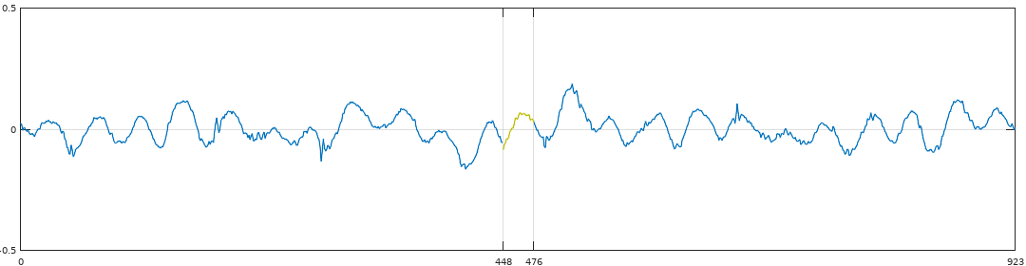
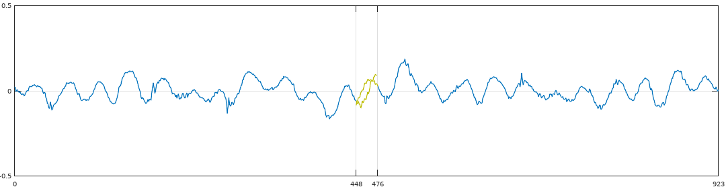
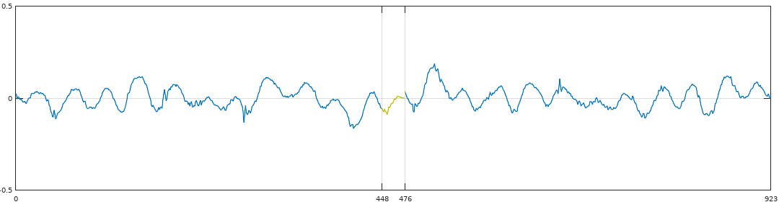
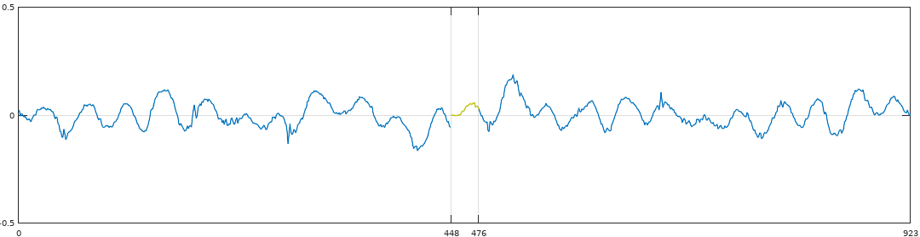
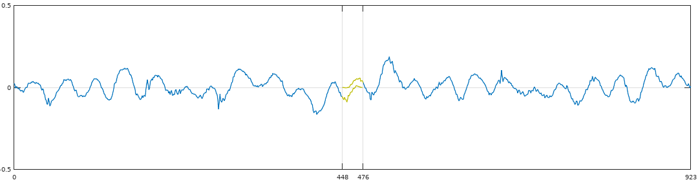
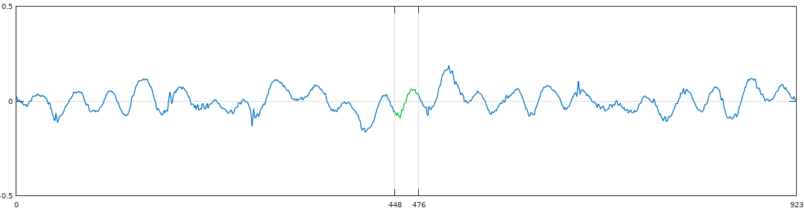
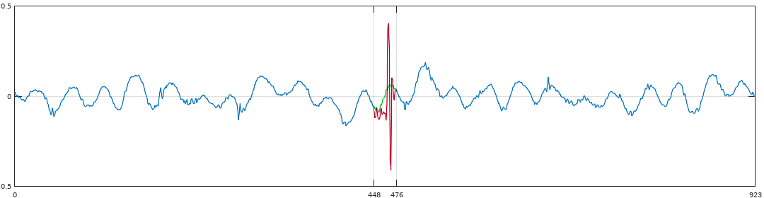
Previous work
Signal reconstruction:
each “marking” is reconstructed independently;
reconstruction is done using linear prediction to generate new audio samples;
linear prediction coefficients – computed using Burg’s method.

Slide 8
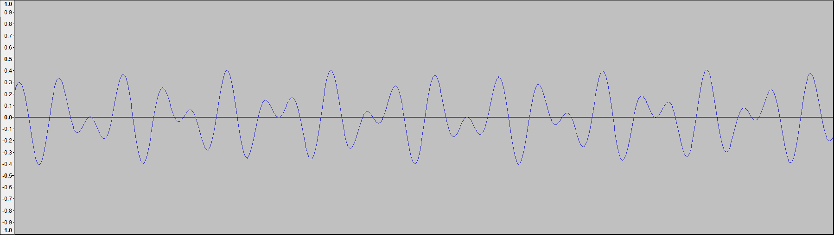
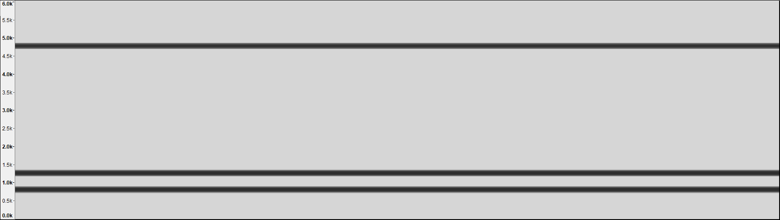
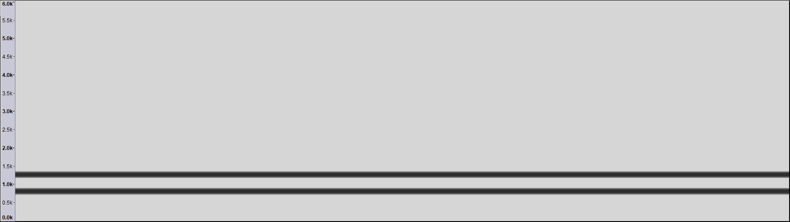
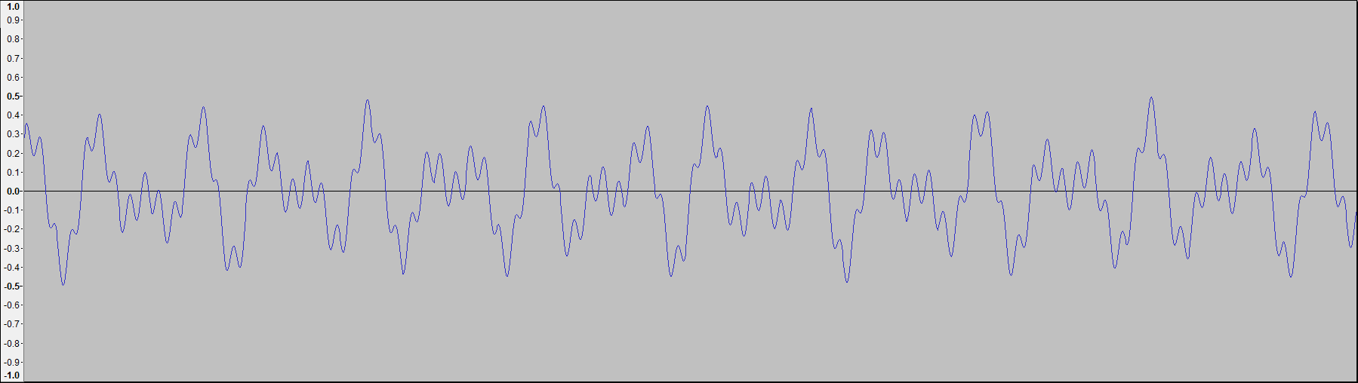
Overlap-Add Short-Time Fourier Transform
Frequency domain filtering:
a faster equivalent to the FIR filters;
based on the Convolution Theorem, which proves that “convolution in the time domain is multiplication in the frequency domain”;
using the Fast Fourier Transform, conversion from time domain to frequency domain and vice-versa can be achieved in θ(Nlog₂N).

Slide 9
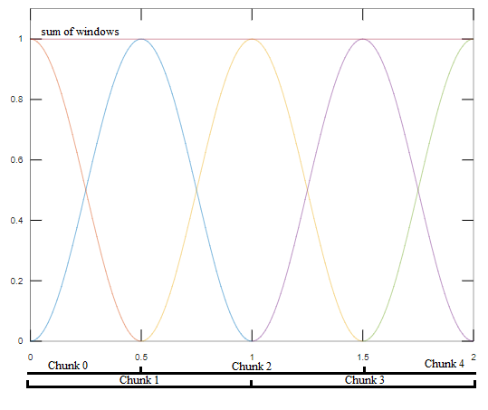
Overlap-Add Short-Time Fourier Transform
OLA STFT :
it is impractical to do the filtering in one go => split the signal into chunks (short-time)
Fourier Transform is for cyclic signals;
an arbitrary signal is acyclic => a suitable
windowing function must be applied
the signal must be split into frames that,
when summed back together, recreate the
original signal

Slide 10
A message-passing Java-Python IPC protocol
DLX STX ETX encoding:
used for framing IPC messages (delimiting each message’s start and end)
a frame begins with the DLE (0x10) STX (0x02) ASCII characters, and ends with DLE (0x10) ETX (0x03) characters
DLE (0x10) bytes in the payload are doubled (stuffed)

Slide 11
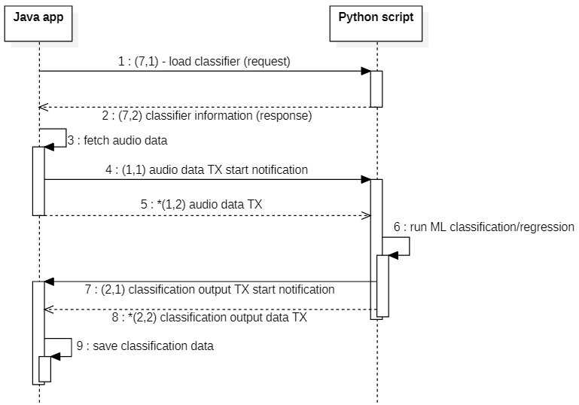
A message-passing Java-Python IPC protocol
IPC messages and communication:
each message has an ID, a subID, and a size, followed by data bytes
sample classification is done using a series of IPC messages to transmit audio data and receive the output of the
neural network

Slide 12
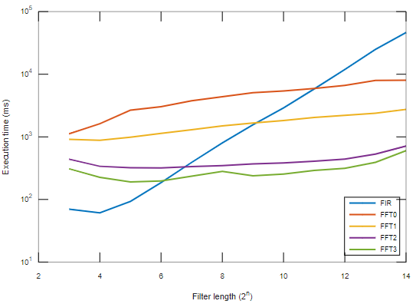
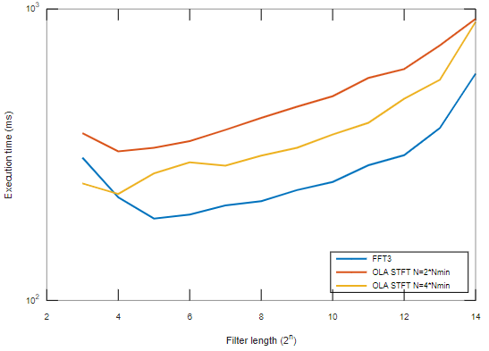
Performance and accuracy results
FFT implementation improvements and FIR vs OLA STFT filtering:

Slide 13
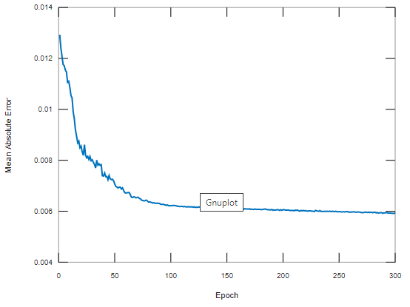
Performance and accuracy results
Classifier training and time performance

Slide 14
Conclusions
Significantly improved the speed of signal filtering by using OLA STFT instead of FIR filters
Increased the robustness and expandability of the IPC mechanism
Increased the speed of sample classification by using a variable-input convolutional network instead of a single-output Multi-Layer Perceptron model
Improved user experience by separating the damage detection and marking generation features, allowing to reuse the NN outputs with different marking generation parameters
Personal contributions
Improved the FFT implementation to be 15-20x faster than the initial algorithm by using sin/cos/bit-reversal tables, memory and call overhead optimizations
Implemented an IPC mechanism from scratch
Tried a variety of NN models, training methods and datasets. The datasets have been generated from records from my personal collection

